Slide 1
PREDICTING COLLEGE ADMISSIONS
DATASCI 112
Mina Ky &
Stephanie Loekman
Notes:
MINA

Slide 2
RESEARCH QUESTION
How can potential applicants predict the admission rate for colleges that don't report?
How can you find colleges that are similar to ones you have already gotten into?
Notes:
Stephanie

Slide 3
WHY IS THIS IMPORTANT?
SCHOOLS HAVE NO INCENTIVE TO PUBLISH ADMISSION RATES
GOAL:
PREDICT ADMIT RATES FOR SCHOOLS THAT DON’T PUBLISH
SOLUTION: ML REGRESSION MODEL
Notes:
STEPHANIE - More competitive colleges in the United States are withholding their admission rates to stop students from being deterred from applying. The goal of the machine learning model is to predict the admission rates for schools that do not report which can help student determine how competitive a college is and determine if they want to apply. We used a regression model because we are predicting a quantitiative variable (the admission rate).

Slide 4
TABLE OF CONTENTS
DATA COLLECTING
AND CLEANING
01
DATA EXPLORATION
02
MAPS
03
FIND COMPARABLE UNIVERSITIES
04
ML MODEL TO PREDICT ADMIT RATES FOR UNREPORTED COLLEGES
05
Q&A
06
Notes:
Stephanie - we are goingto

Slide 5
01 DATA COLLECTING AND CLEANING
Notes:
Mina

Slide 6
COLLEGE SCORECARD API
01
PARAMS
02
FIELDS
03
LOOP THROUGH PAGES
04
CREATE DATAFRAME FROM LIST
Restricting to only include predominantly undergraduate institutions
Deciding which fields to include (State, City, Enrollment Number)
Over 2600 institutions and max 100 colleges per page
Loop through 26 pages and append each college to list
df_colleges = pd.json_normalize(results)
Notes:
Fields

Slide 7
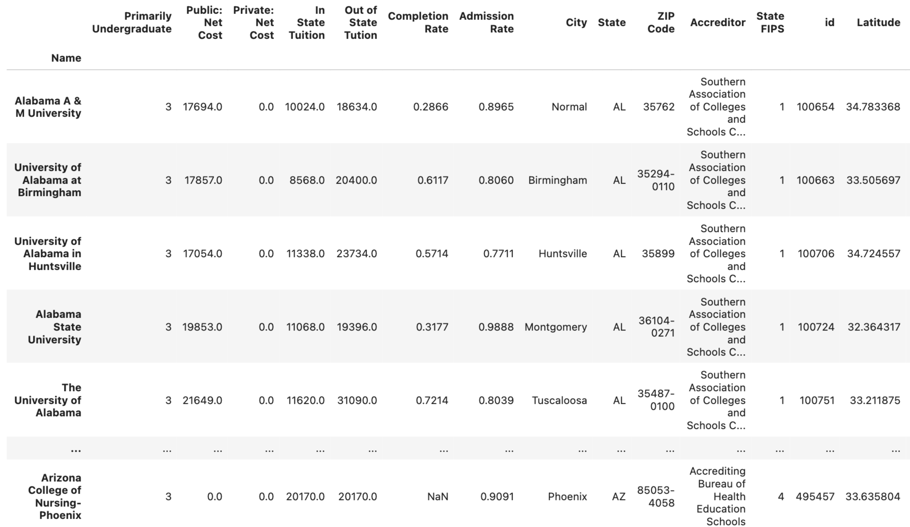
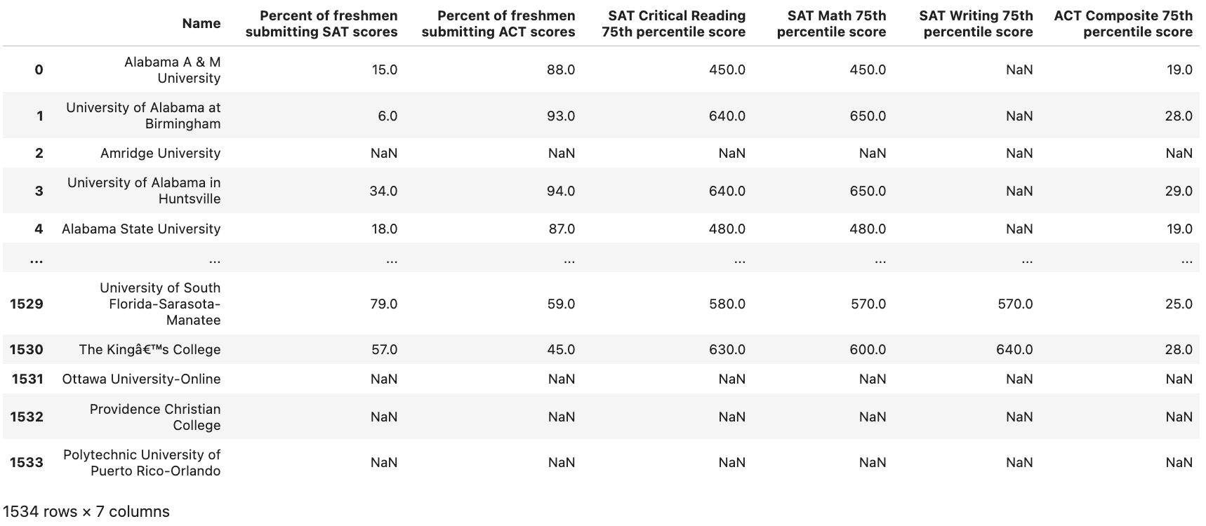
MERGING DATAFRAMES
COLLEGE DEMOGRAPHICS
TESTING STATISTICS
Notes:
Stephanie -
We got the testing files from a Kaggle competition. Our left dataframe which consists of the college demographics (left), the right dataframe shows updated test statistics
college demographics left = college scorecard API
Testing statistics = kaggle website

Slide 8
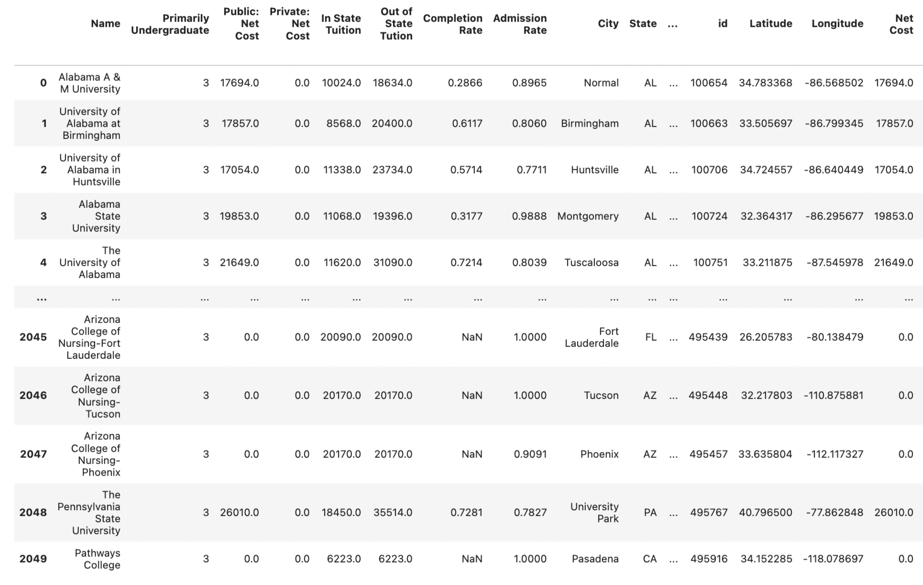
MERGED DATASET
df_merged = df_colleges.merge(df_testing, on = "Name", how = "left")
df_merged
Notes:
( I merged the dataframes based on the institution name on a left merge because the college demographics dataframe seems more comprehensive, and it will remove colleges that aren't primarily undergraduate insitutions.
Merge data sets together on institution merge so it drops all non-4 year unis that aren’t focused on bachelor degrees, save index of schools that don’t report college admission rates

Slide 9
WEB SCRAPING FLAGSHIP COLLEGES
FEATURES
DATAFRAME
MERGING TWO DATAFRAMES
Name, Location, Population appended into lists
Created df_flagship DataFrame using 3 lists
Merged new Dataframe with College Demographics Dataframe. Left merge to only include flagship colleges
Notes:
Mina

Slide 10
02 DATA EXPLORATION
Notes:
Mina

Slide 11
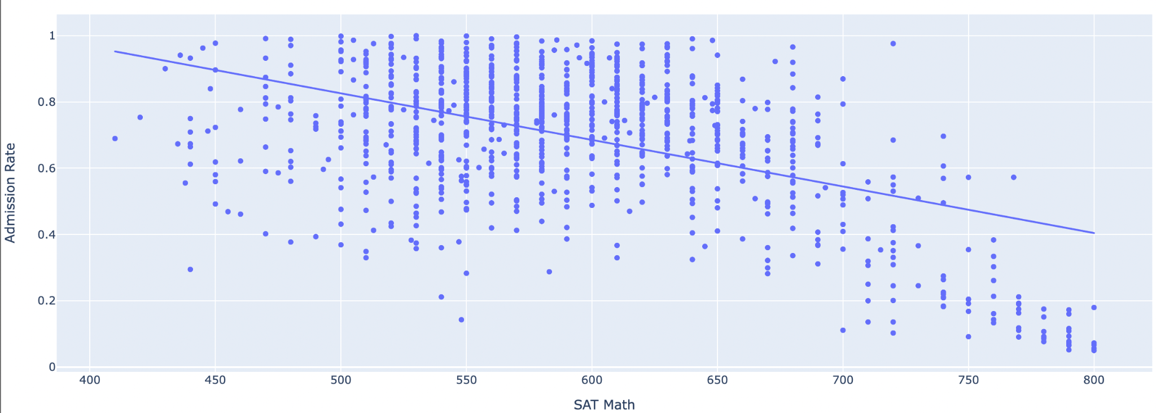
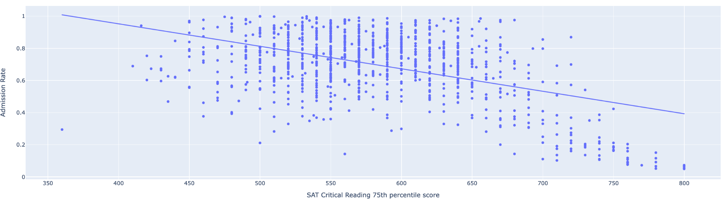
SAT MATH
& ADMISSION RATE
SAT CRITICAL READING
& ADMISSION RATE
R -0.499
R -0.484
Notes:
There is a -0.499 correlation between SAT Math 75th percentile score and admission rate which is a moderately strong negative correlation. On the scatter plot, we can see an overall negative correlation between SAT MATH 75th percentile score and admission rate. There is a -0.484 correlation between SAT Critical Reading 75th percentile score and admission rate which is also a moderately strong negative correlation. On the scatter plot, we can see an overall negative correlation between SAT Critical Reading 75th percentile score and admission rate.
This makes sense because schools that are more competitive to get into will usually only take students with higher SAT scores.

Slide 12
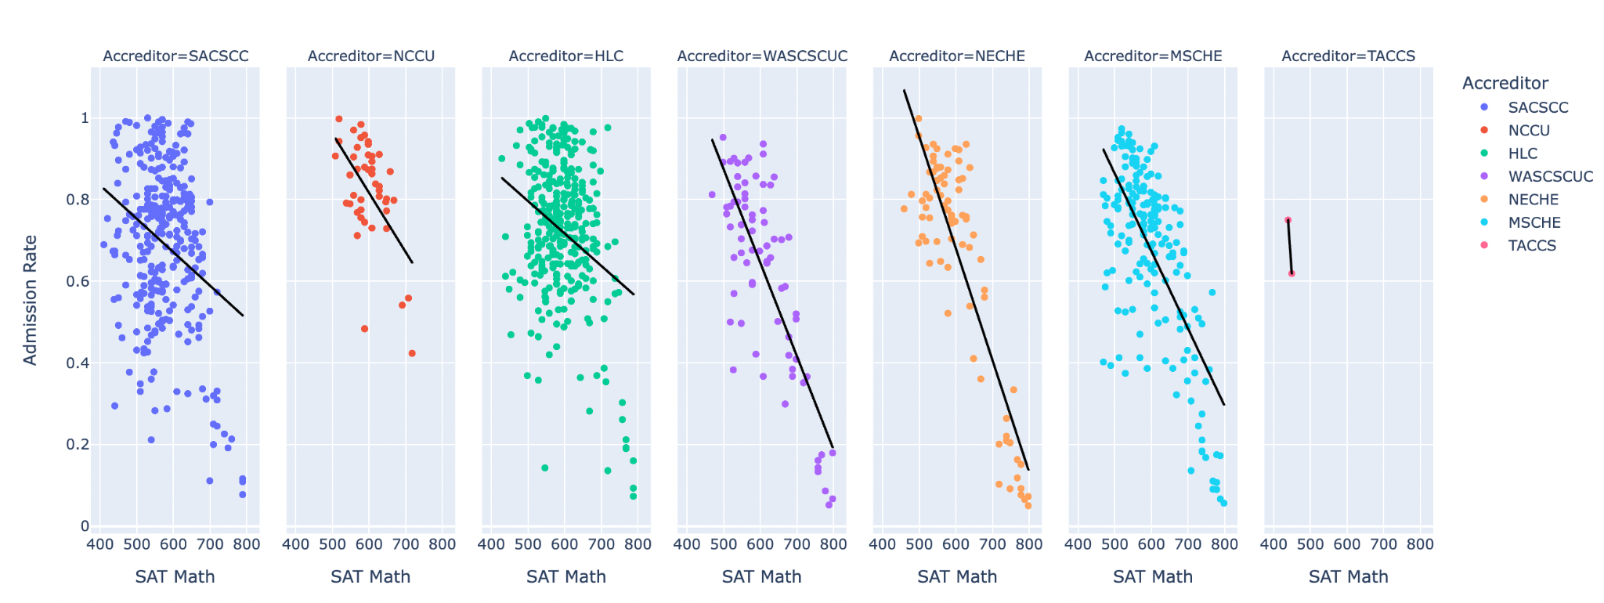
CORRELATION BETWEEN DIFFERENT ACCREDITORS
-0.29
-0.87
px.scatter(X_train, x="SAT Math", y="Admission Rate", facet_col = "Accreditor", trendline="ols", color = "Accreditor", trendline_color_override= "black")
Notes:
Mina-
Different accreditors are often associated with different regions so most schools in the South will be certified by the Southern Association of Colleges.
While every graph shows a negative correlation, the strength of the correlation heavily varies.
The strongest correlation are found in schools that are accredited by the New England Commission on Higher Education at -0.87 while the weakest correlation is from the Southern Association of Colleges at -0.29.

Slide 13
03 MAPS
Notes:
stephanie

Slide 14
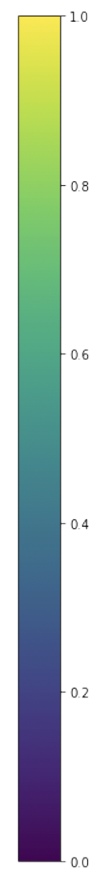
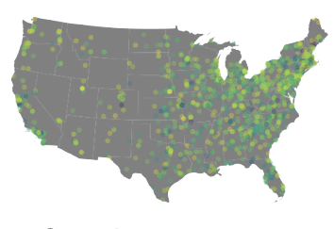
COLLEGE DOT MAP: COLORED BY ADMISSION RATE
Each dot = 1 college
Shows admission rate based on color of each dot
most competitive = purple
Least competitive = yellow
Used State FIP codes and merge to state shapefile
Use Geopandas
Notes:
Stephanie - The graph shows each college and their respective locations on a U.S map. It also shows the admission rate based on the color of each dot. There are many colleges on the east coast and west coast, while there were not as many in the center probably because of population differences. Schools with lower admission rates (purple) are scattered around the map with quite a few being on the east coast.
Each dot is a college,
Lots of colelges on east coast, competitive ones are scattered across the US

Slide 15
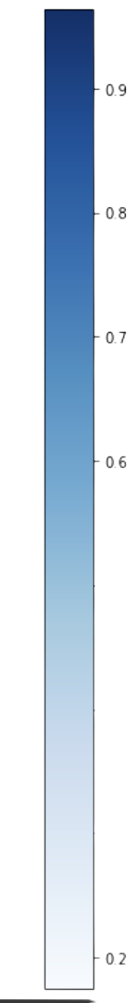
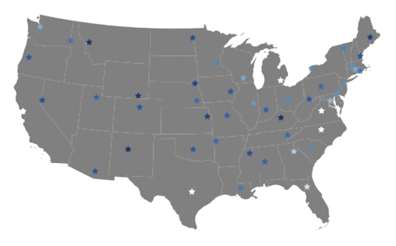
FLAGSHIP COLLEGES DOT PLOT
Created GeoDataFrame based on the flagship DataFrame we web scrapped
Set to same crs as state Geodataframe
Changing facecolor, linewidth, marker, markersize, and cmap
Set X_Lim and Y_Lim to only include continental USA
BERKELEY
KU
Notes:
MINA -
We limited the dots to only flagship colleges so we could compare the best colleges of each state. We created a geodataframe based on the flagship dataframe, set the coordinate reference system to the same as the state geodataframe, changed parameters so the marks were easy to see, and set the x and y limits to only include the continental US.
The lighter dots which signify lower admission rates are around the coasts and in more-populated states like Berkeley.,while the flagship colleges in the middle of the country still have relatively high admission rates like University of Kansas. This shows that not all the flagship colleges are competitive to get into, and if you want to go to a well-known competitive college, you may want to travel outside your original state.

Slide 16
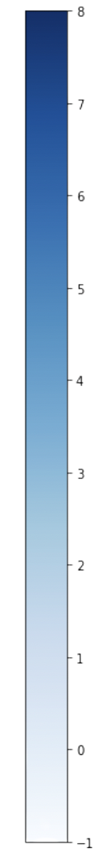
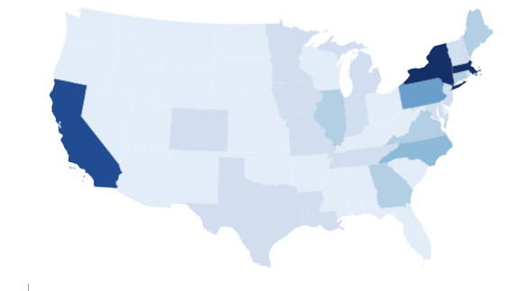
ELITE COLLEGES CHOROPLETH
Defining an Elite College (>30% acceptance rate &
<690 SAT score)
Groupby State FIP Code to find number of elite colleges in each state
Merge with state GeoDataFrame
Change vmin to -1, so states with 0 elite schools still appear
Notes:
MINA-
We defined elite colleges as colleges that had a lower than 30% acceptance rate and had a higher than a 690 75th Percentile SAT score for both Math and Critical Reading.
We grouped by State FIP Code and used the count function to find the number of elite colleges in each state, and merged this with the state GeoDataFrame on State Fip Code.
On the map, the darker blue states have relatively more elite colleges while lighter blue states have no elite colleges. California,New York and Massachusetts the most 5 elite schools.

Slide 17
04 FIND COMPARABLE UNIVERSITIES
Notes:
stephanie

Slide 18
COMPARABLE UNIVERSITIES USING DISTANCE METRICS
SELECT DATA
SCALE VARIABLES
SORT BY LOWEST DISTANCE
PAIRWISE
DISTANCES
Choose colleges w/ complete data: SAT score, Completion Rate, Tuition, Location
Schools with lowest distance from compared school = most comparable universities
Notes:
There are so many higher institutions in the United States that many students feel overwhelmed when trying to find schools that they can get into. They may overlook colleges that would accept them if they just applied. By using distance metrics, we are able to find colleges with similar statistics as a college that a potential applicant has already gotten into. This will allow the student to optimize their chances of applying to schools they can get into.
We used the same features as the machine learning model, most notably

Slide 19
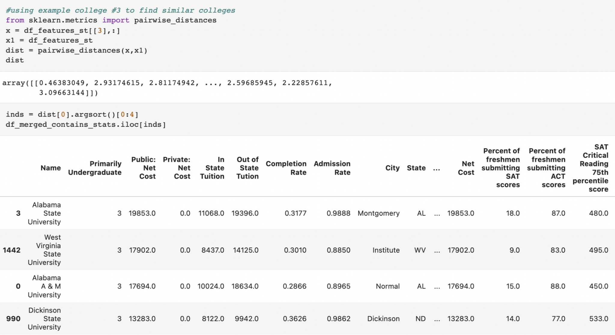
Notes:
So this is how it works, in this example college #3 represents Alabama State university,
The Top Three Schools that are most similar to Alabama State University are West Virginia State University, Alabama A&M University, and Dickinson State University. You can replace the 3 with the index of the college you want to find comparable colleges to and it will return the top 3 most similar colleges to that respective college.

Slide 20
05 ML MODELS
Notes:
Stephanie

Slide 21
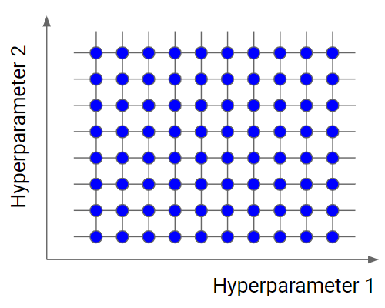
FEATURE SELECTION & HYPERTUNING
Best features:
State, Accreditor, SAT Math 75th percentile score, Percent of freshmen submitting SAT scores, Completion Rate, and In State Tuition were the best features
max_leaf_nodes
loss
Best parameters:
loss: absolute_error
max_leaf_node: 13
min_sample_leaf: 5
Notes:
We used a for loop to loop through different combinations of features and we found that the best features were State, Accreditor Sat Math, and so on
Using GridSearch CV, we tested three different parameters which were loss, max_leaf_nodes, and min_samples_leaf

Slide 22

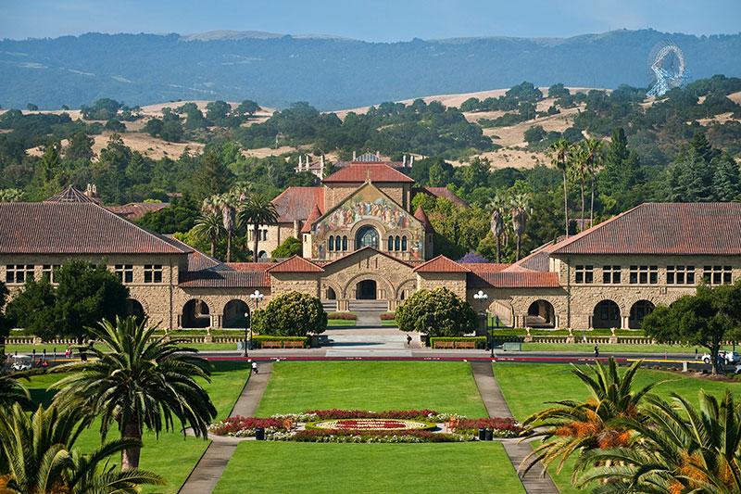
APPLYING MODEL ON STANFORD UNIVERSITY
array([0.05540299])
4.7%
Notes:
Mina - We applied the model on Stanford University to see what it would predict the admission rate as. It returned as 5.5% admission rate. When compared to the actual rate that year, it was only 0.8% off.

Slide 23
0.140
0.147
COMPARING MODELS
HistGradientBoostingRegressor
RandomForestRegressor
lower RMSE→ better model
-Features: State, Accreditor, SAT Math, % submitted SAT, Completion Rate, Tuition
-Parameters: loss: 'absolute_error', max_leaf_nodes: 13, min_samples_leaf: 5
-Features: State, Accreditor, SAT Math, SAT Critical Reading, Completion Rate, Net Cost
-Parameters: criterion: ‘absolute_error', min_samples_leaf: 2, n_estimators: 41
Notes:
Mina- When we repeated this process of feature selection and hypertuning on 2 other models which were the random forest regressor and the SGD regressor, we were able to select which was the best model based on which one returned the lowest Root Mean Squared Error for the dataset. The RMSE for the first model is 0.007 lower than the second, so it is the better model for predicting admission rates.

Slide 24
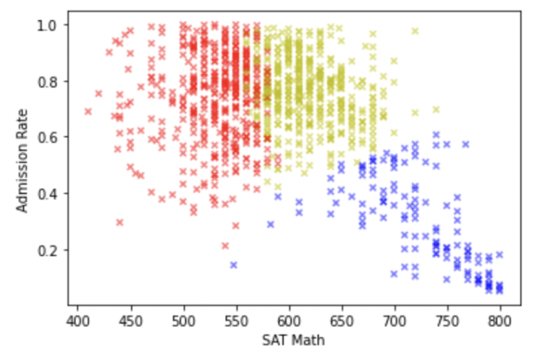
K MEANS CLUSTERING TO CATEGORIZE COLLEGES
1
ELITE
2
MIDDLE
3
SAFETY
Notes:
Stephanie - The blue cluster is elite colleges that have high average test scores and have low admission rates; Many people would consider these reach schools. The yellow cluster comprises of semi-competetive colleges that require medium SAT scores but range from medium to high admission rates which many people would consider target schools. The red cluster is low-competitive colleges that have generally higher admission rates rates and will on average accept students with lower test scores. These would often be considered safety schools.

Slide 25
Thank you!
Questions?

